Slide 1
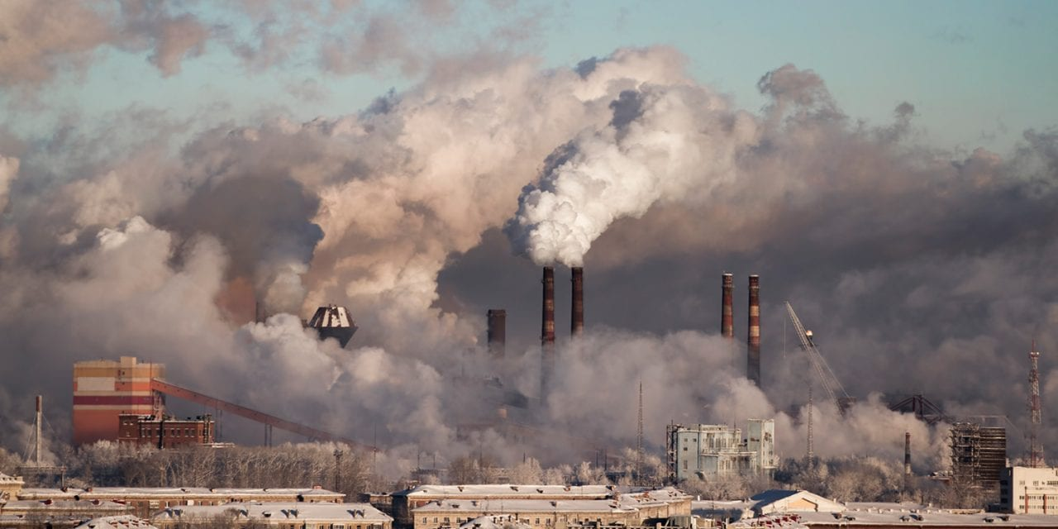
Air pollution
Artificial Intelligence
Alexander, Dennis, Hélène

Slide 2
The data
Data provided by RATP from 3 Parisian subway stations: Chatelet, Auber, Franklin D. Roosevelt (one csv file for each)
Data from jan. 2013 to oct. 2021, 1 measurement per hour
Features: NO (Nitrogen Monoxide), NO2 (Nitrogen Dioxide) - both from fuel combustion, CO2 exhaled by commuters, PM10 particles resulting from frictions, temperature and humidity +PM2.5 for Auber station only
All data types are object: need to reformat to feed it to models
Interpolation to fill missing values

Slide 3
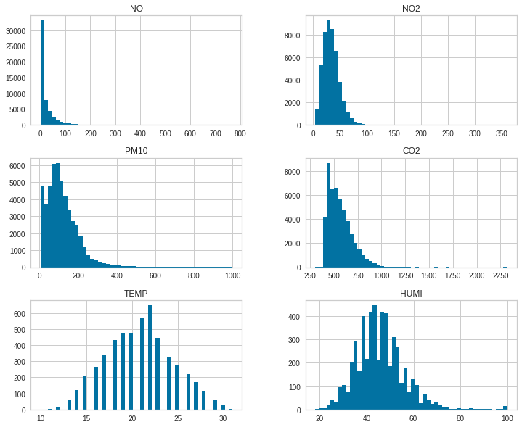
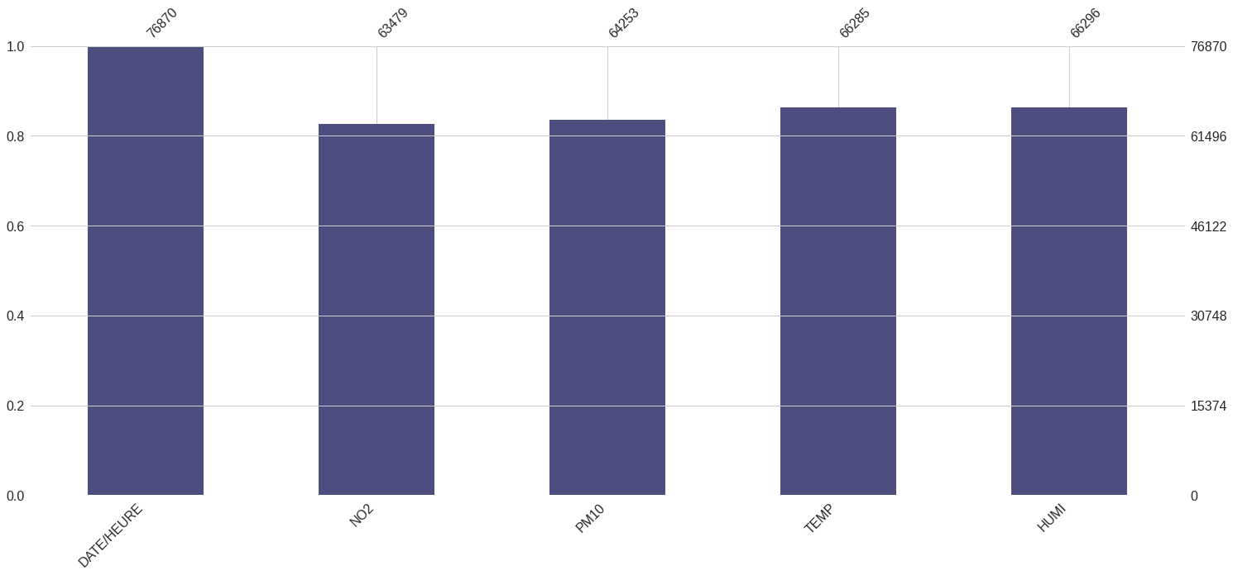
Overview of data - Chatelet
Temperature and humidity are nearly normally distributed
Other features are more or less right-skewed
A lot of missing values to deal with (~60k)

Slide 4
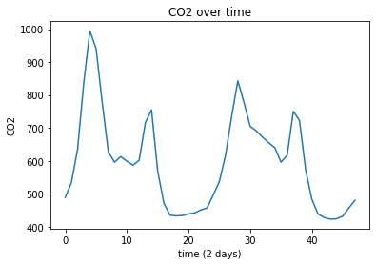
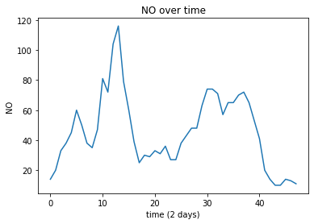
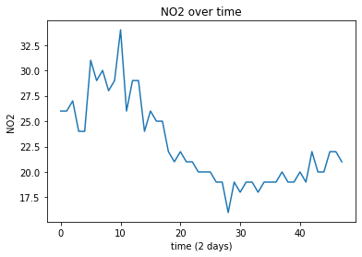
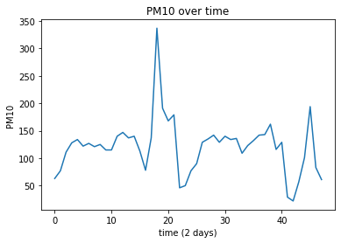
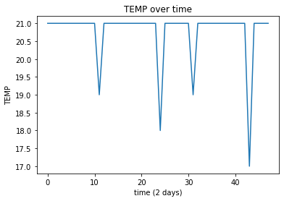
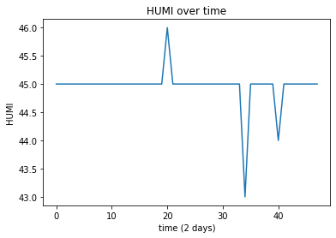
Predict CO2 level in Chatelet from time of day, temperature and humidity

Slide 5
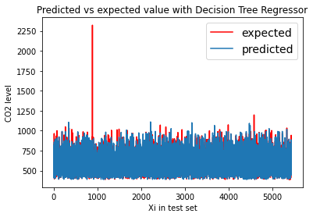
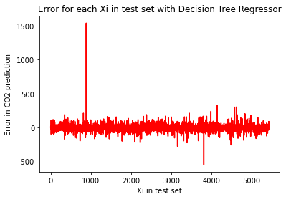
CO2 prediction with Decision Tree Regressor
In training with CV:
Average MAE: 25.702, STD MAE: 0.684
In Test:
Mean absolute error: 25.566

Slide 6
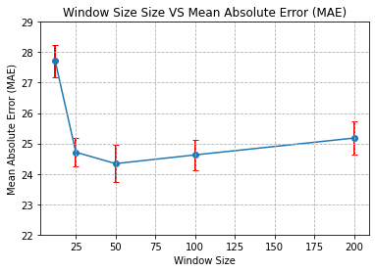
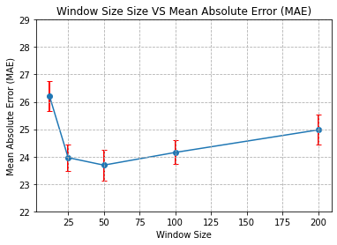
CO2, Station: Châtelet
CO2[t-1], CO2[t-2], …
TEMP[t], TEMP[t-1], …
HUMI[t], HUMI[t-1], …
hour[t], hour[t-1], …
weekday[t], weekday[t-1], …
month[t], month[t-1], ...
Using linear model with l2 regularization (ridge, alpha=1)
10 cross fold validation, 3 repetitions
CO2, Station: Châtelet
CO2[t-1], CO2[t-2], …
NO[t], NO[t-1], …
NO2[t], NO2[t-1], …
PM10[t], PM10[t-1], …
TEMP[t], TEMP[t-1], …
HUMI[t], HUMI[t-1], …
hour[t], hour[t-1], …
weekday[t], weekday[t-1], …
month[t], month[t-1], …
Using linear model with l2 regularization (ridge, alpha=1)
10 cross fold validation, 3 repetitions
MODEL 1
MODEL 2

Slide 7
MODEL 1
MODEL 2

Slide 8
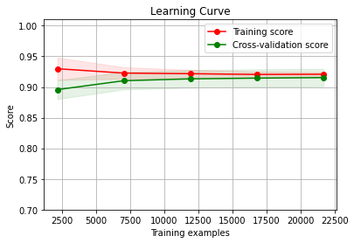
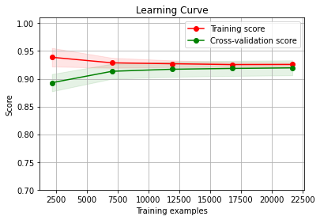
MODEL 1
MODEL 2

Slide 9
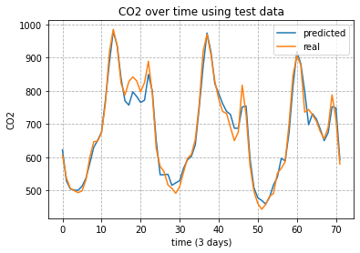
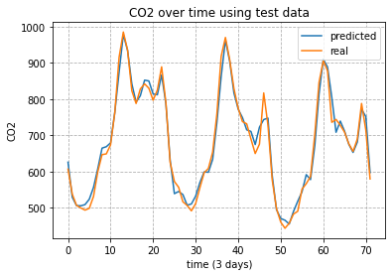
MODEL 1
MODEL 2

Slide 10
Predicting the CO2 in the next day
Prediction start at: 2018-02-20 03:00:00
Station: Chatelet
MODEL 2

Slide 11
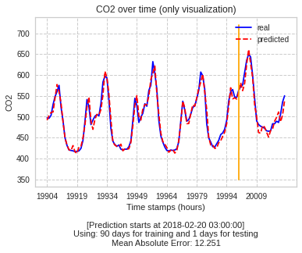
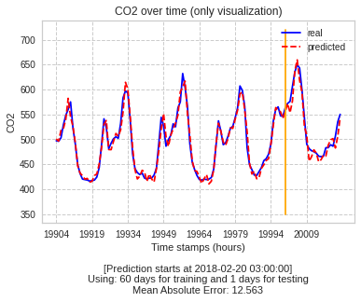

Slide 12
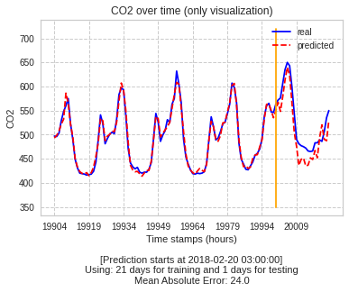
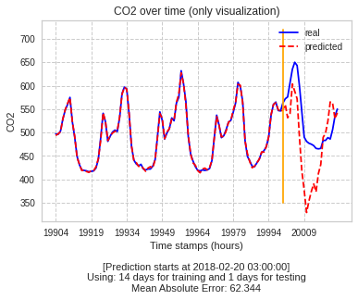

Slide 13

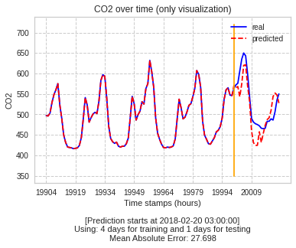

Slide 14
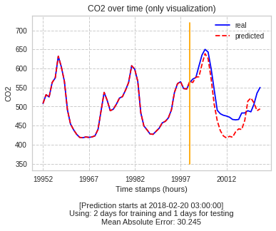
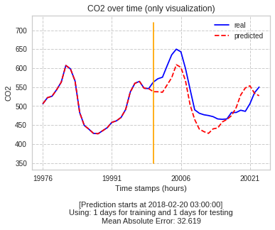

Slide 15
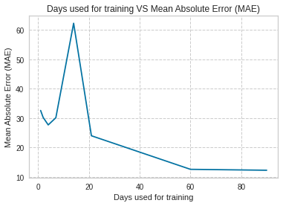

Slide 16
Predicting the CO2 in the next week
Prediction start at: 2018-02-20 03:00:00
Station: Chatelet
MODEL 2

Slide 17
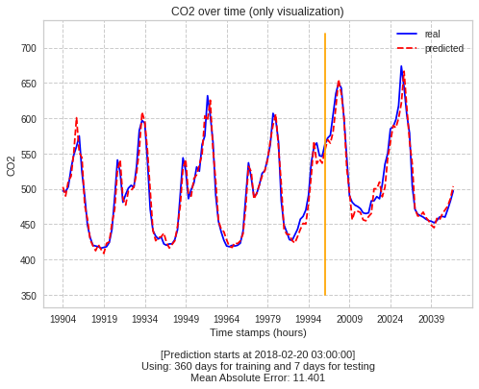
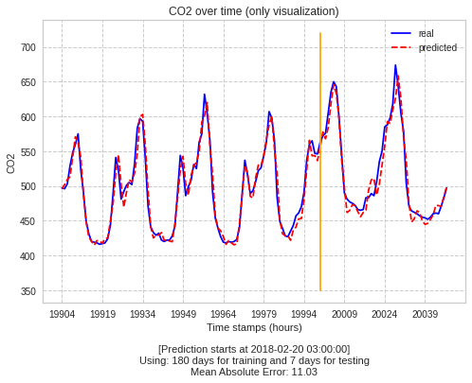

Slide 18
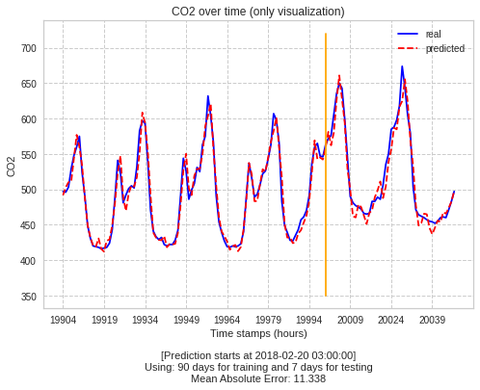
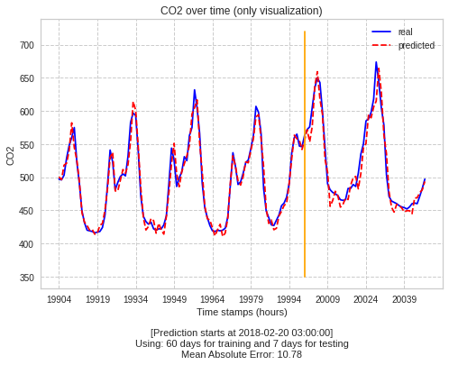

Slide 19
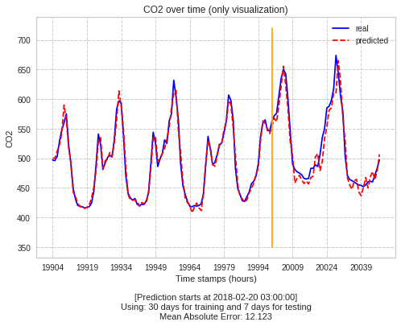
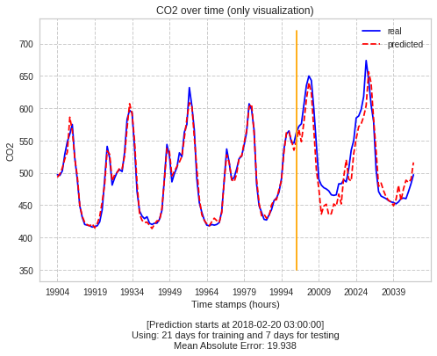

Slide 20
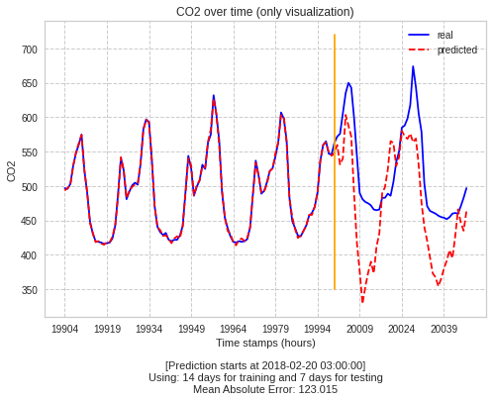
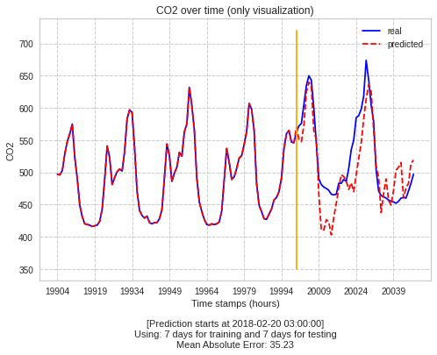

Slide 21
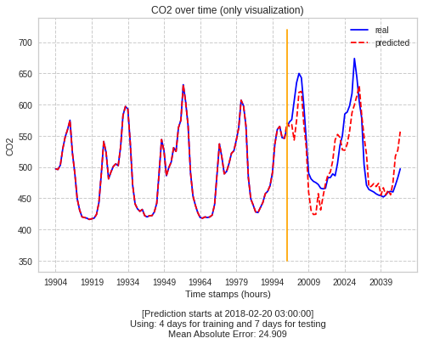
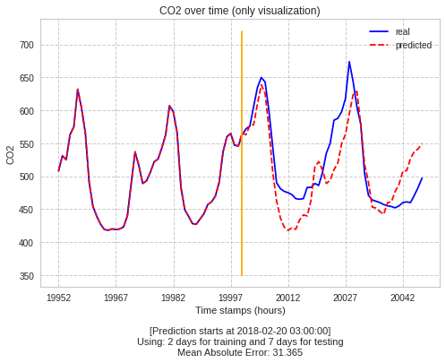

Slide 22
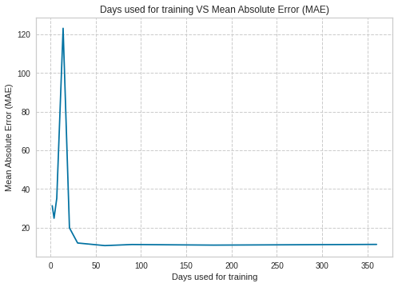

Slide 23
Predicting the CO2 in the next month
Prediction start at: 2018-02-20 03:00:00
Station: Chatelet
MODEL 2

Slide 24

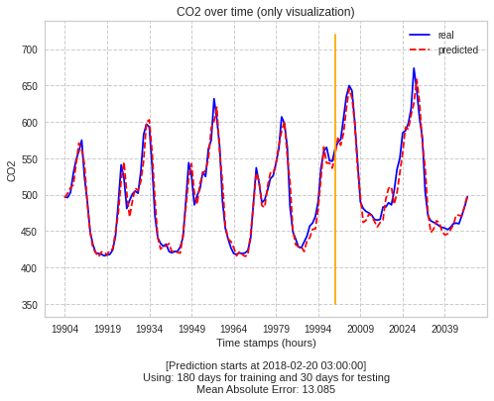

Slide 25



Slide 26
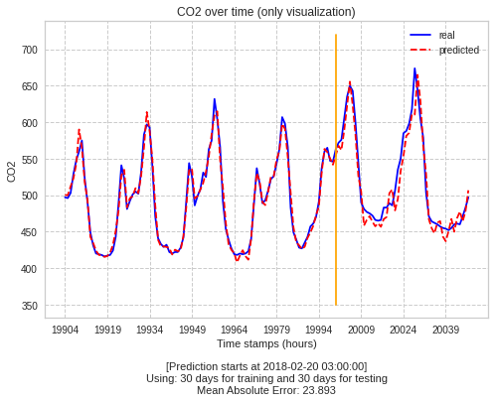


Slide 27



Slide 28



Slide 29
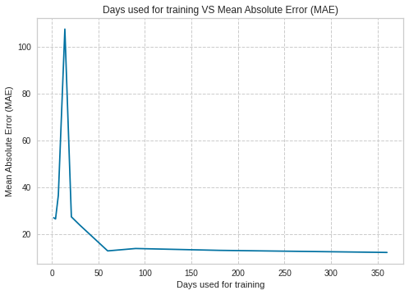

Slide 30
Predicting the CO2 in the next year
Prediction start at: 2018-02-20 03:00:00
Station: Chatelet
MODEL 2

Slide 31

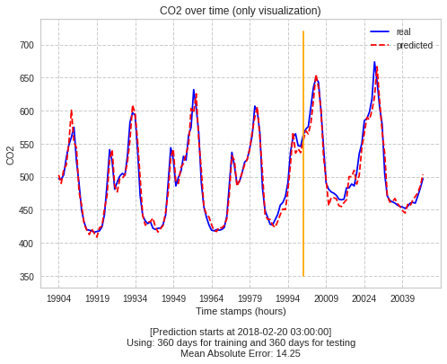

Slide 32



Slide 33

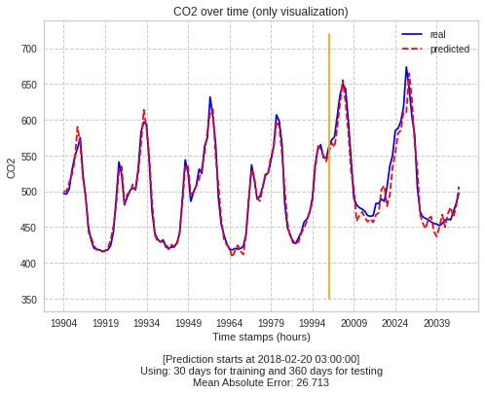

Slide 34



Slide 35



Slide 36
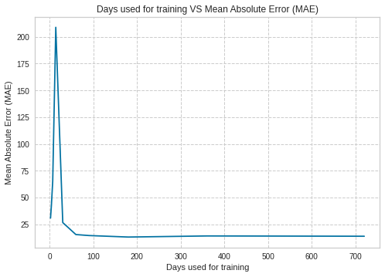

Slide 37
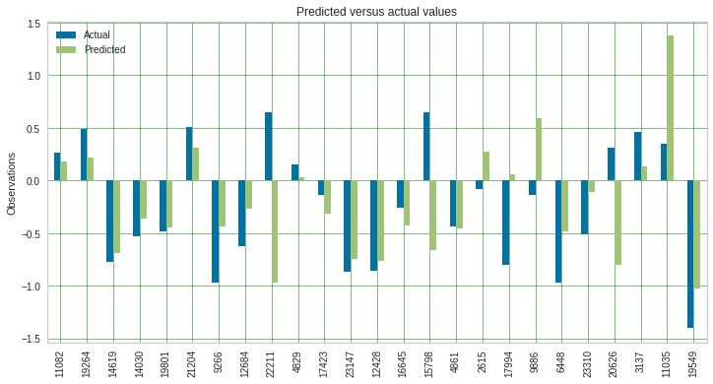
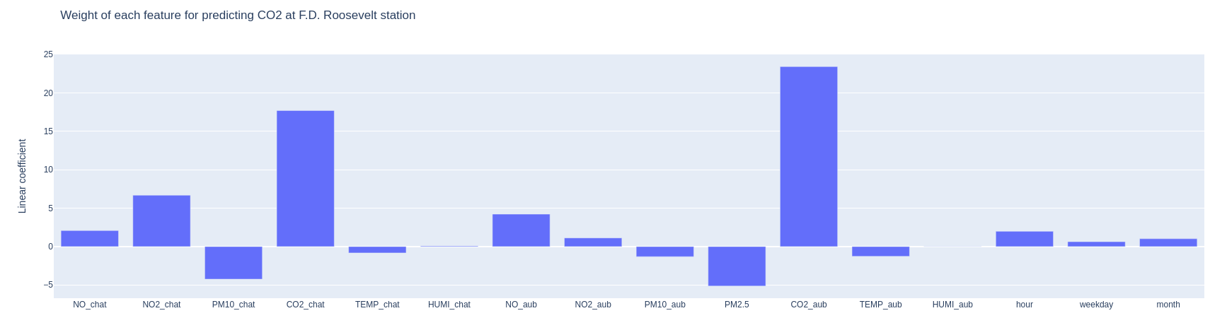
Can current levels in 2 stations help predict levels in 3rd station ?
We aim to predict CO2 levels at Franklin Roosevelt station based on all other features for Chatelet and Auber
Linear regression model trained on continuous attributes and dummies, all standardized
Unsurprisingly, most useful to make this prediction are CO2 levels at Chatelet and Auber. Explanation is simple: number of travelers vary in the same way at 3 stations

Slide 38
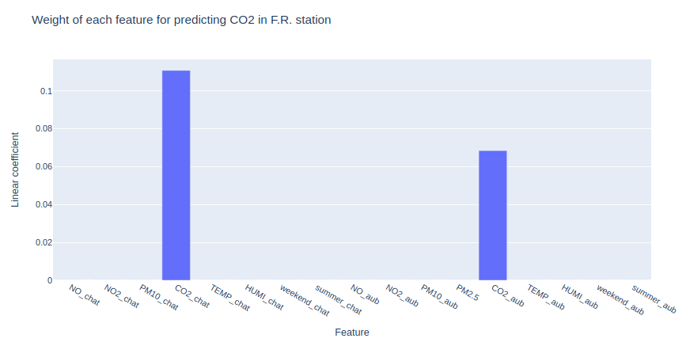
Comparison: without regularization, with Ridge to shrink large coefficients to avoid overfitting and with Lasso to reduce number of features
 | Without regularization | Ridge | Lasso
Explained variance | 0.53 | 0.54 | 0.21
Mean Absolute Error | 0.51 | 0.50 | 0.67
Median Absolute Error | 0.39 | 0.40 | 0.54
Mean Squared Error | 0.47 | 0.44 | 0.77
Root mean squared error | 0.68 | 0.67 | 0.88
R2 score | 0.53 | 0.54 | 0.21
Lasso only retained 2 features

Slide 39
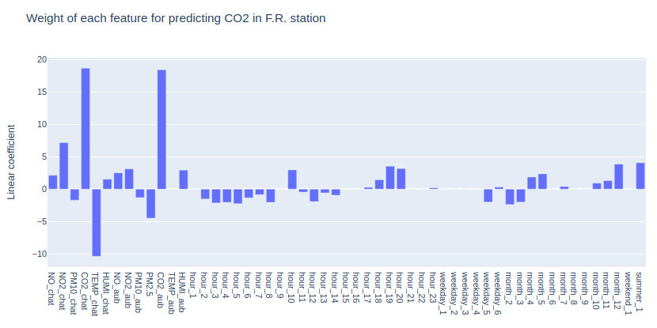
Increasing the number of features
We dummify hours, weekdays, months, weekend, summer to get 56 features
With Lasso, explained variance increases from 0.21 to 0.57
Lasso only useful when large number of variables

Slide 40
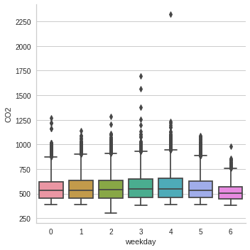
CO2 levels depending on day of the week for Chatelet, Roosevelt and Auber
Looks like clustering should be interesting

Slide 41
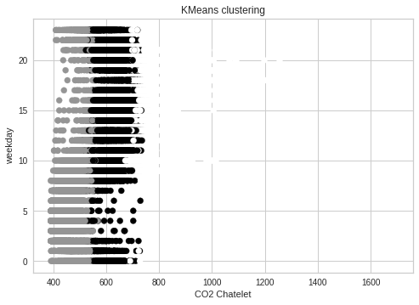
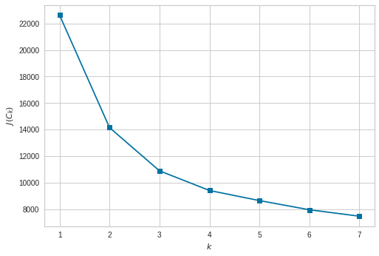
Clustering attempt
2D cluster
Inertia or within cluster sum-of-squares

Slide 42
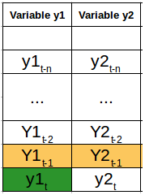

More on the clustering attempt
Try to predict with Vector Auto Regression on whole data set and then only on clusters

Slide 43

More on the clustering attempt

Slide 44

More on the clustering attempt

Slide 45
THANK YOU

